Slide 1
Analysis of H&E images Updates Luiz Maniero 07/10/2025

Slide 2
Merge
Nuclei
CD45
CD45_416_-_20x_BF_05_crop_2
*I did it for all images
Nuclei mask
CD45 mask

Slide 3
Merge
Nuclei
bGAL
B_Gal_420_-_20x_BF_02_crop_1
*I did it for all images
Nuclei mask
bGAL mask

Slide 4
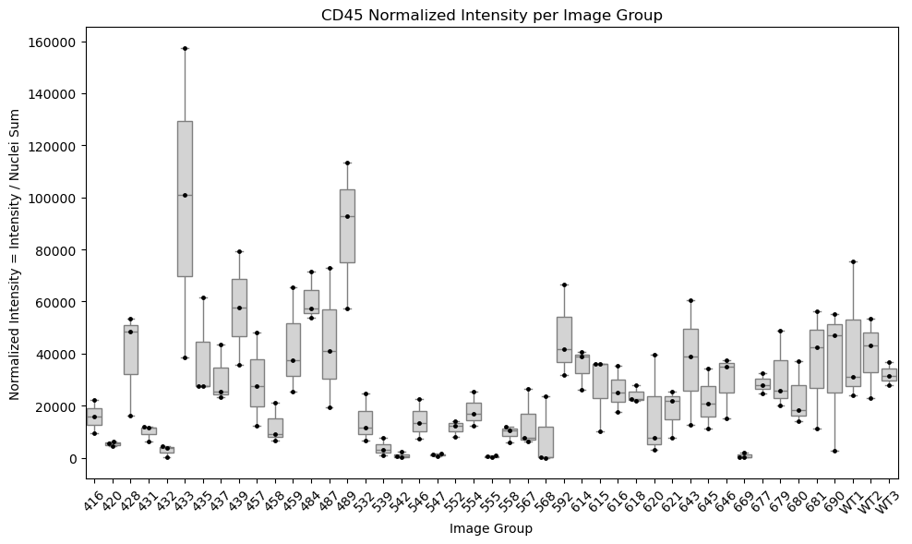

Slide 5
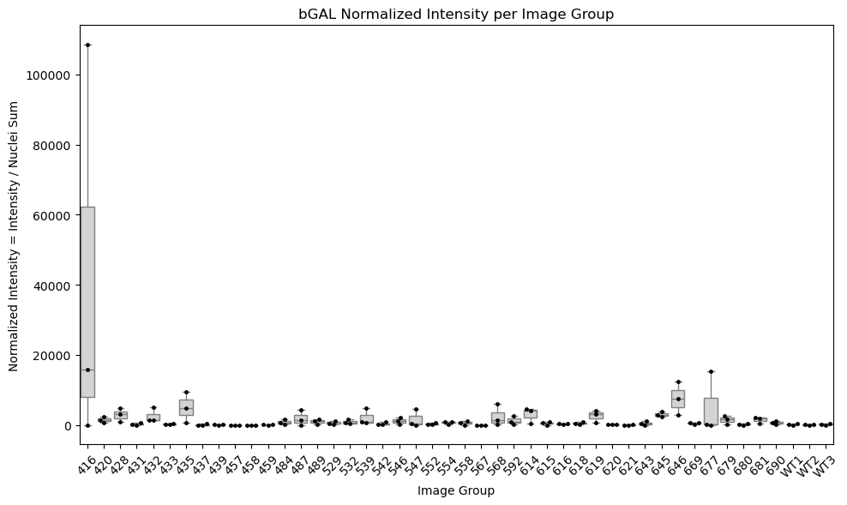

Slide 6
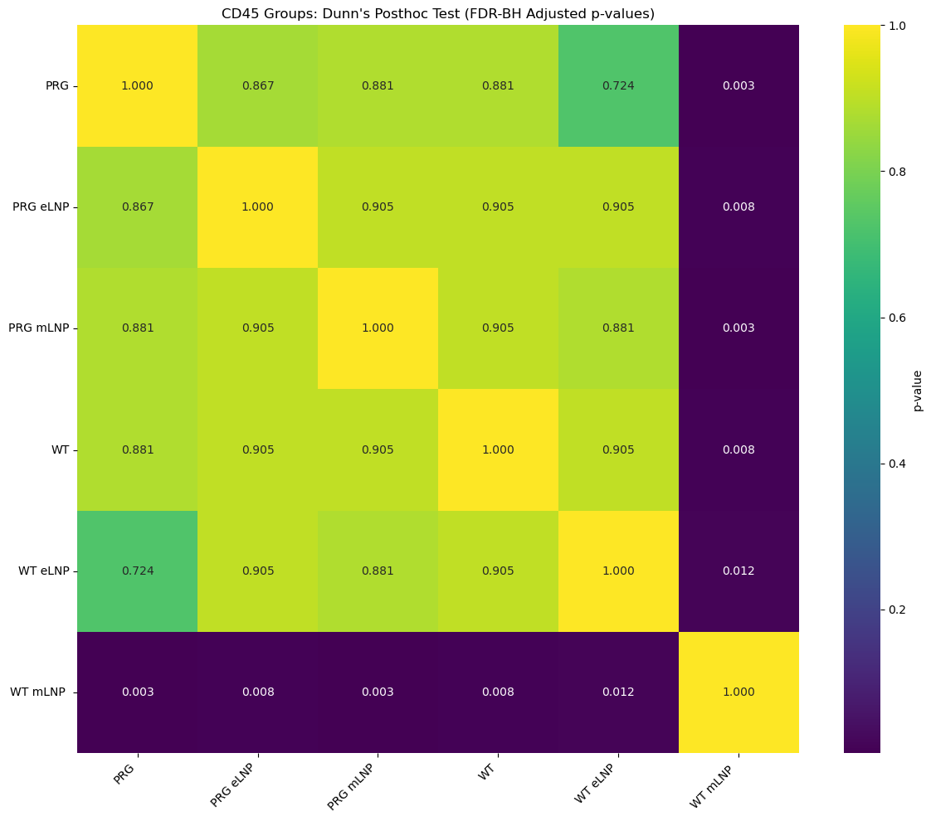
CD45 ANALYSIS
I only compared between conditions; it does not consider 3months or 5 months of injection.
Due to the characteristics of the data, I performed a non-parametric test (Kruskal-Wallis).
Result: Kruskal-Wallis H-statistic = 19.334,
p-value = 0.00167
Then, I did a post hoc test (Dunn) to correct p-value with Benjamini Hochberg, comparing within each condition.
Heatmap shows adjusted p-value for each comparison.

Slide 7
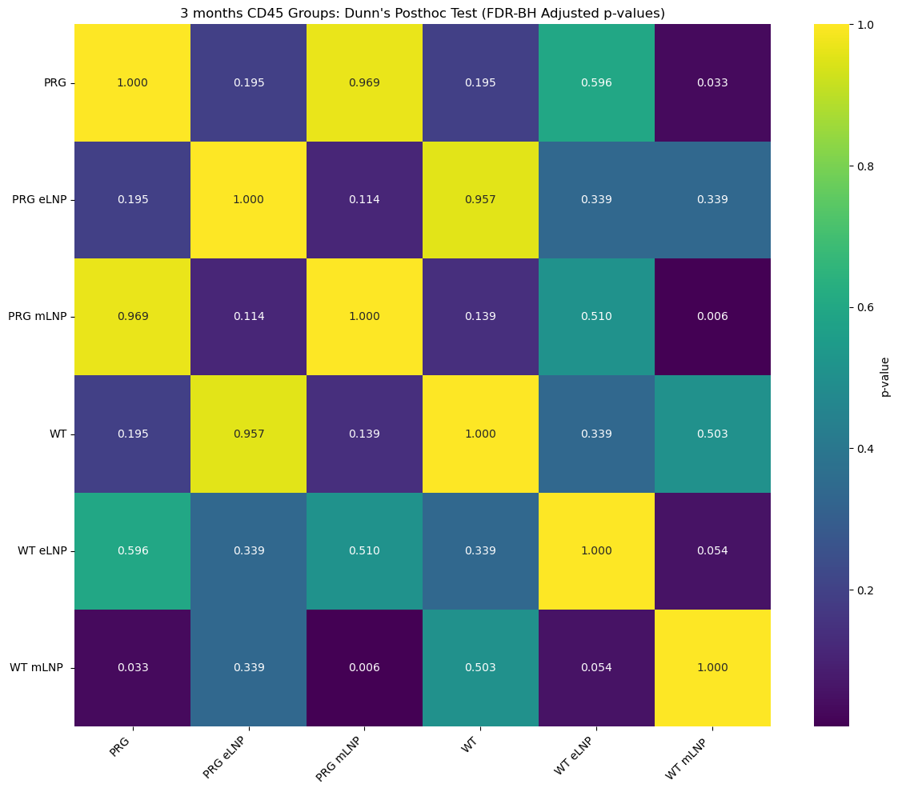
CD45 ANALYSIS
Now, I subset our data based on months, in this case I selected 3 MONTHS.
I performed a non-parametric test (Kruskal-Wallis).
Result: Kruskal-Wallis H-statistic = 17.395, p-value = 0.00381
Then, I did a post hoc test (Dunn) to correct p-value with Benjamini Hochberg, comparing within each condition at 3 months.
Heatmap shows adjusted p-value for each comparison.

Slide 8
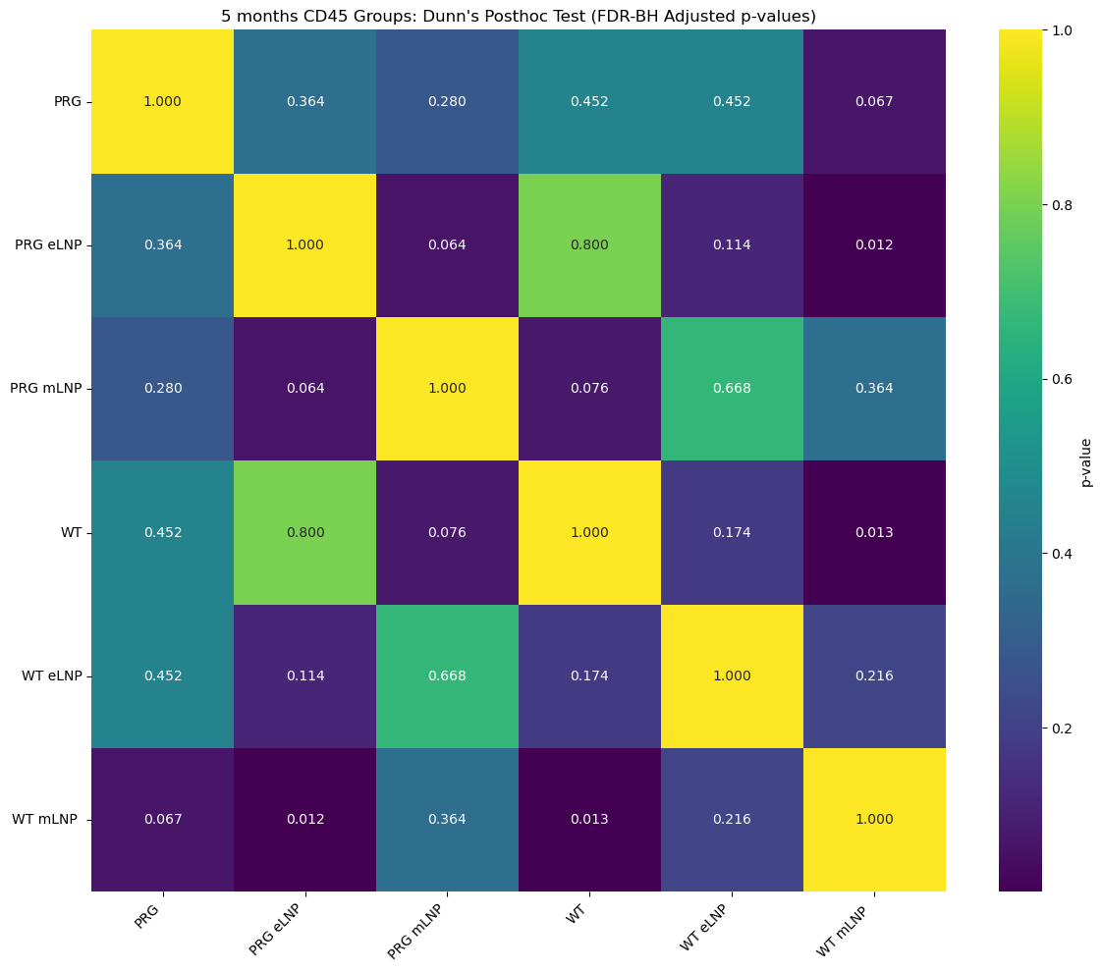
CD45 ANALYSIS
Now, I subset our data based on months, in this case I selected 5 MONTHS.
I performed a non-parametric test (Kruskal-Wallis).
Result: Kruskal-Wallis H-statistic = 17.152, p-value = 0.00422
Then, I did a post hoc test (Dunn) to correct p-value with Benjamini Hochberg, comparing within each condition at 3 months.
Heatmap shows adjusted p-value for each comparison.

Slide 9
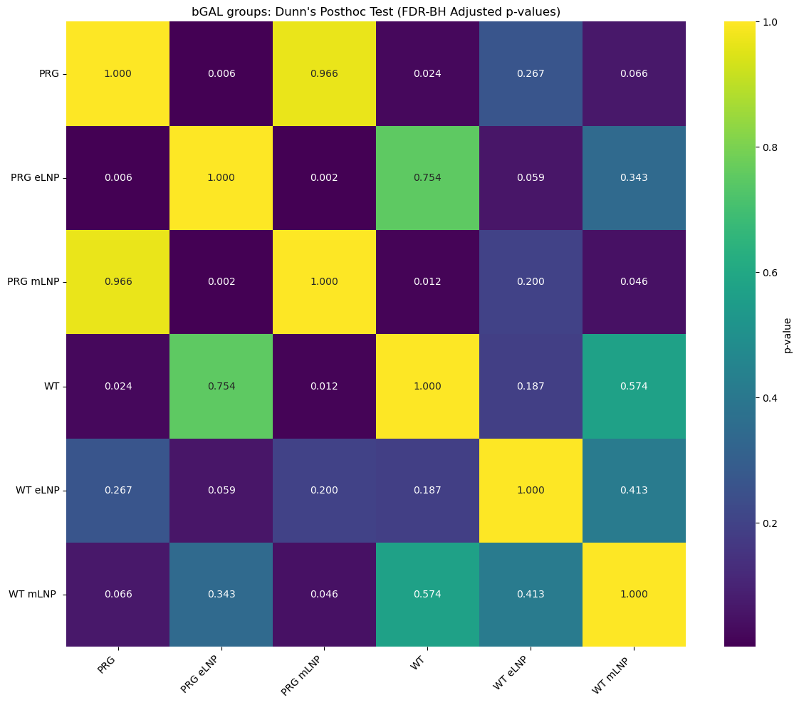
bGAL ANALYSIS
I only compared between conditions; it does not consider 3months or 5 months of injection.
Due to the characteristics of the data, I performed a non-parametric test (Kruskal-Wallis).
Result: Kruskal-Wallis H-statistic = 23.144, p-value = 0.000317
Then, I did a post hoc test (Dunn) to correct p-value with Benjamini Hochberg, comparing within each condition.
Heatmap shows adjusted p-value for each comparison.

Slide 10
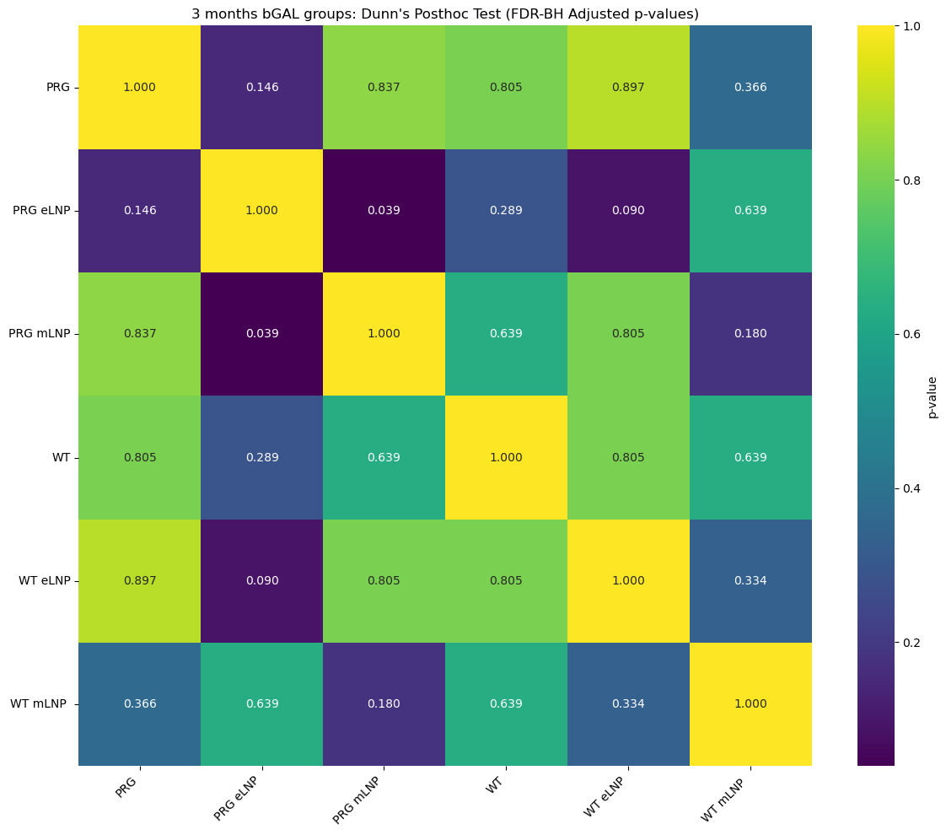
bGAL ANALYSIS
Now, I subset our data based on months, in this case I selected 3 MONTHS.
I performed a non-parametric test (Kruskal-Wallis).
Result: Kruskal-Wallis H-statistic = 12.483, p-value = 0.0287
Then, I did a post hoc test (Dunn) to correct p-value with Benjamini Hochberg, comparing within each condition at 3 months.
Heatmap shows adjusted p-value for each comparison.

Slide 11
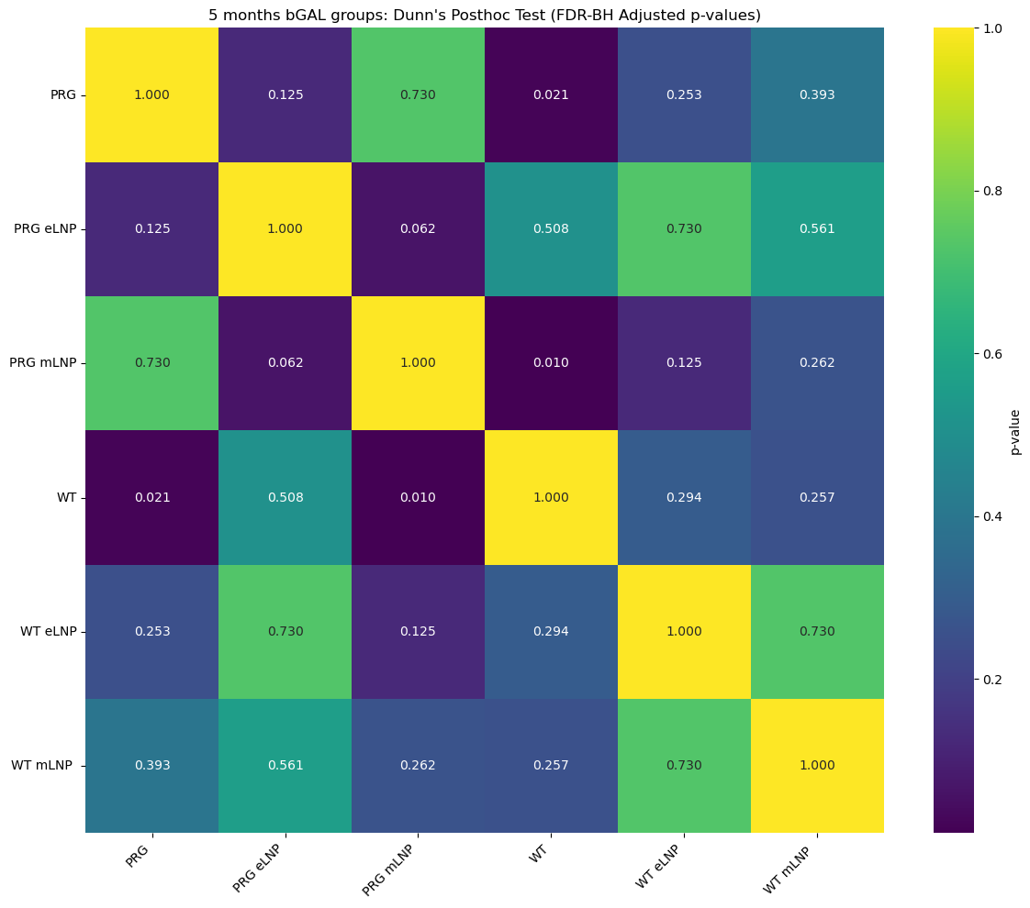
CD45 ANALYSIS
Now, I subset our data based on months, in this case I selected 5 MONTHS.
I performed a non-parametric test (Kruskal-Wallis).
Result: Kruskal-Wallis H-statistic = 16.372, p-value = 0.00586
Then, I did a post hoc test (Dunn) to correct p-value with Benjamini Hochberg, comparing within each condition at 3 months.
Heatmap shows adjusted p-value for each comparison.

